Slide 1


Artificial Intelligence with Python

Slide 2
AGENDA
INTRODUCTION TO ARTIFICIAL INTELLIGENCE
WHY PYTHON FOR AI?
FEATURES OF PYTHON
PYTHON PACKAGES FOR AI

Slide 3
01
INTRODUCTION TO ARTIFICIAL INTELLIGENCE

Slide 4

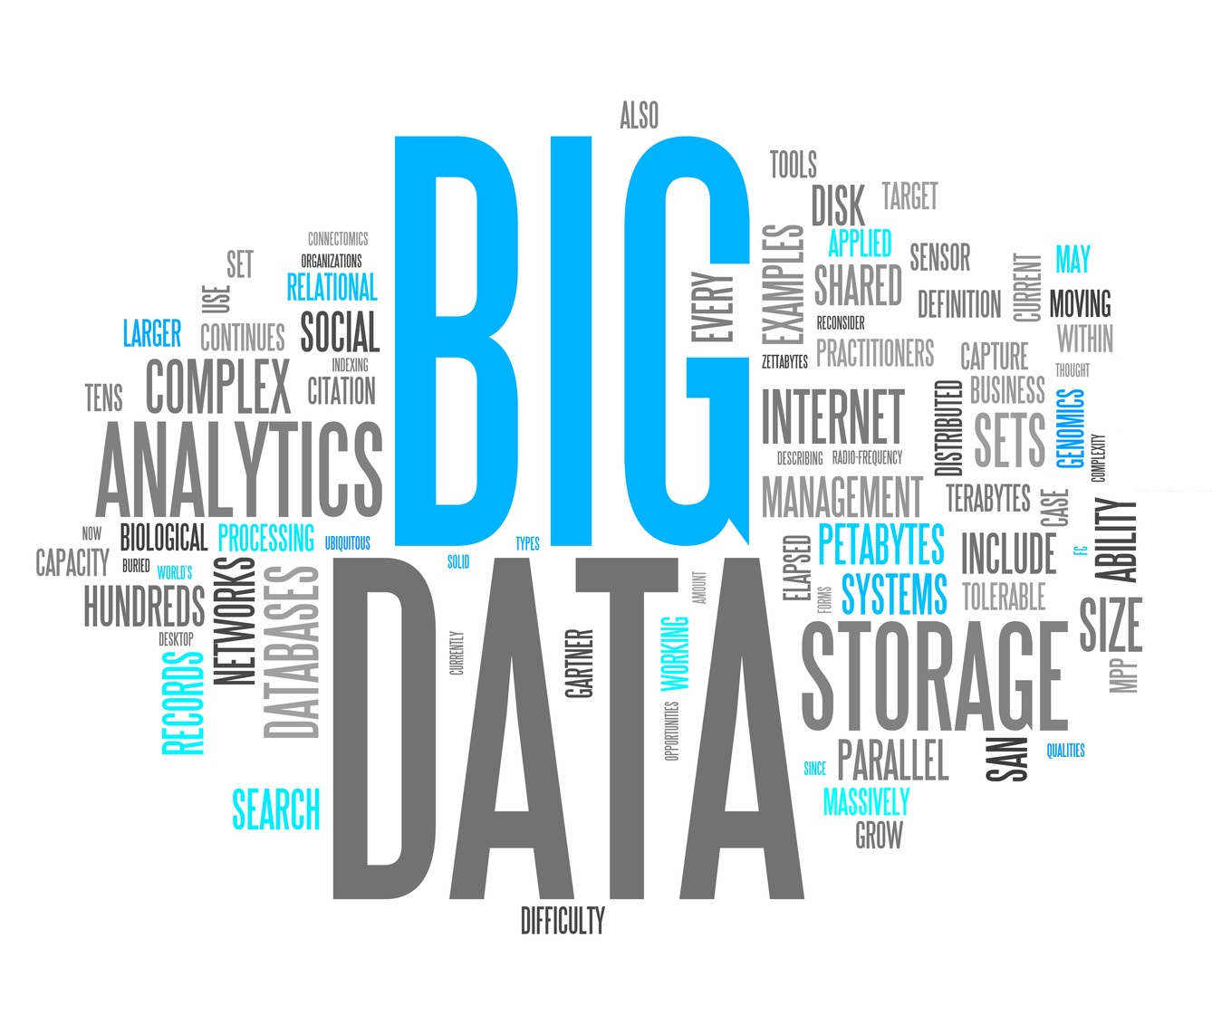


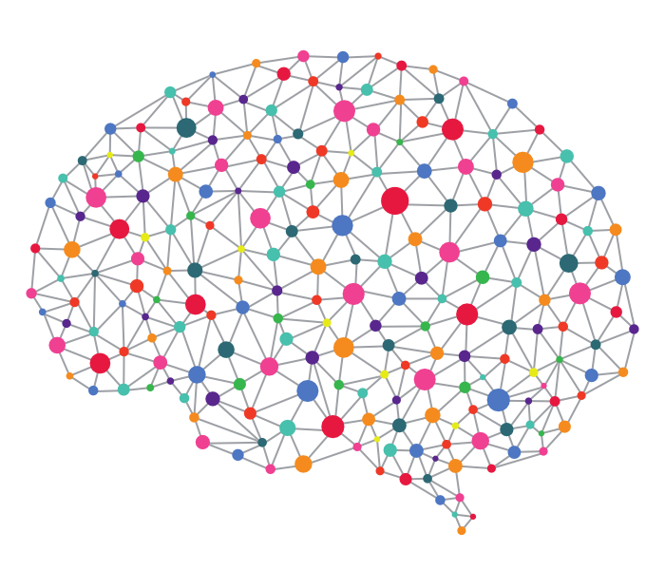
DEMAND OF AI
More Computational
Power
More Data
Better algorithms
Broad Investment

Slide 5
WHAT IS AI?
The theory and development of computer systems able to perform tasks normally requiring human intelligence, such as visual perception, speech recognition, decision-making and translation between languages.
Machine Learning
NLP
Knowledge Base
Deep Learning
Computer Vision
Expert System

Slide 6
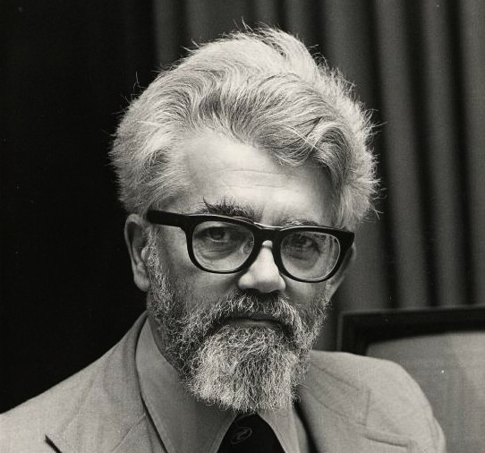
John McCarthy first coined the term Artificial Intelligence in the year 1956.
“The science and engineering of making intelligent machines”

Slide 7

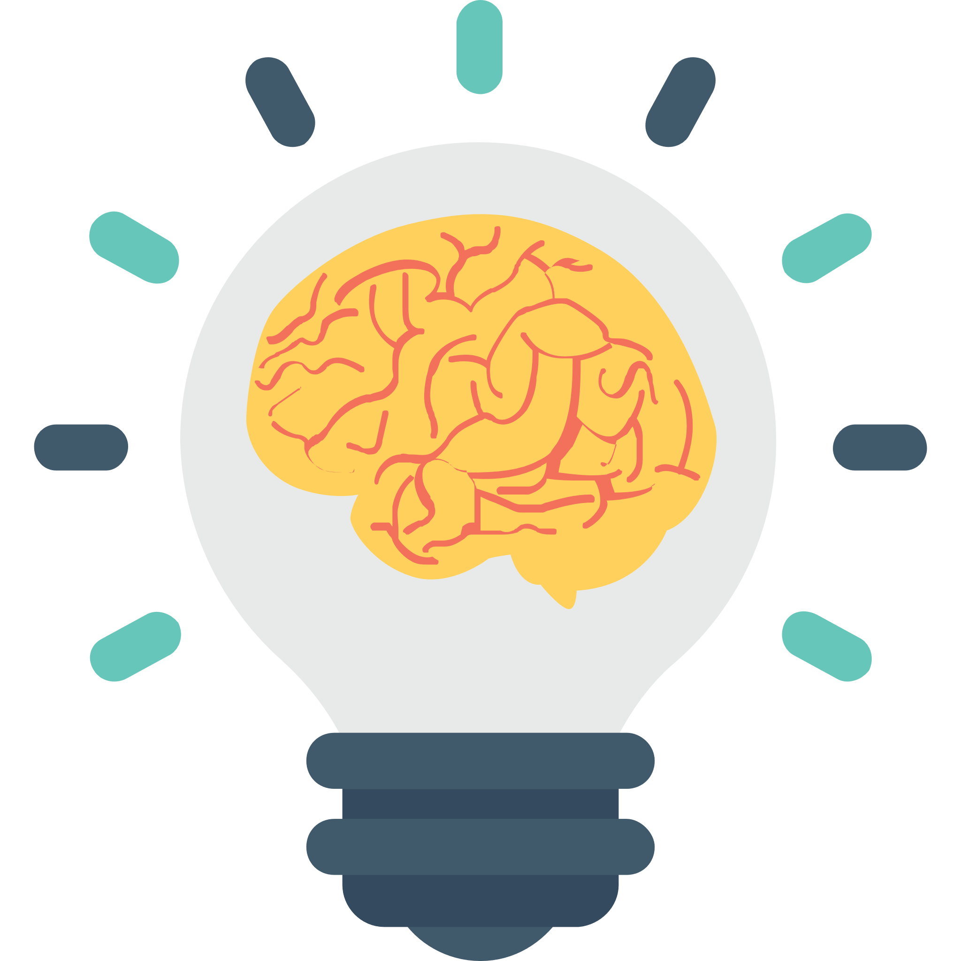
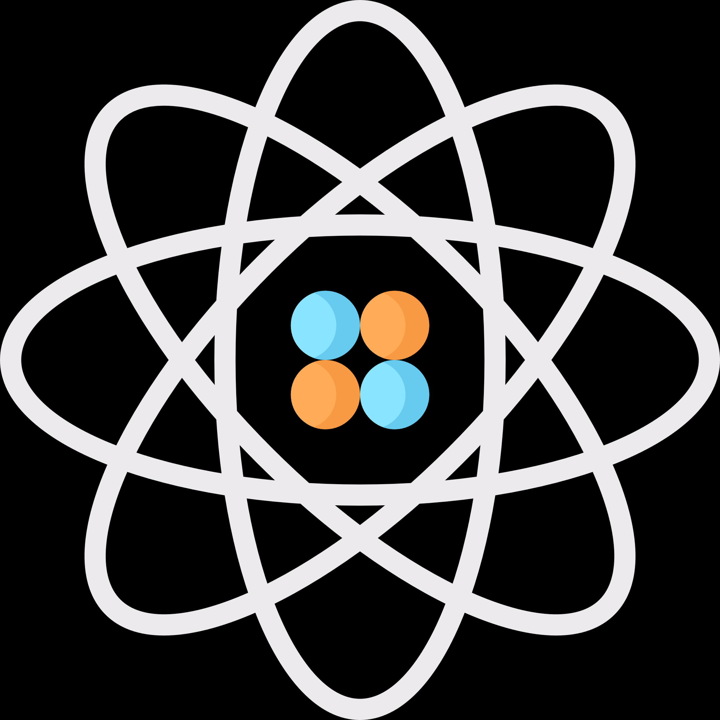
TYPES OF AI
The theory and development of computer systems able to perform tasks normally requiring human intelligence, such as visual perception, speech recognition, decision-making and translation between languages.
Artificial Narrow Intelligence
Artificial General Intelligence
Artificial Super Intelligence

Slide 8
02
WHY PYTHON FOR AI?

Slide 9
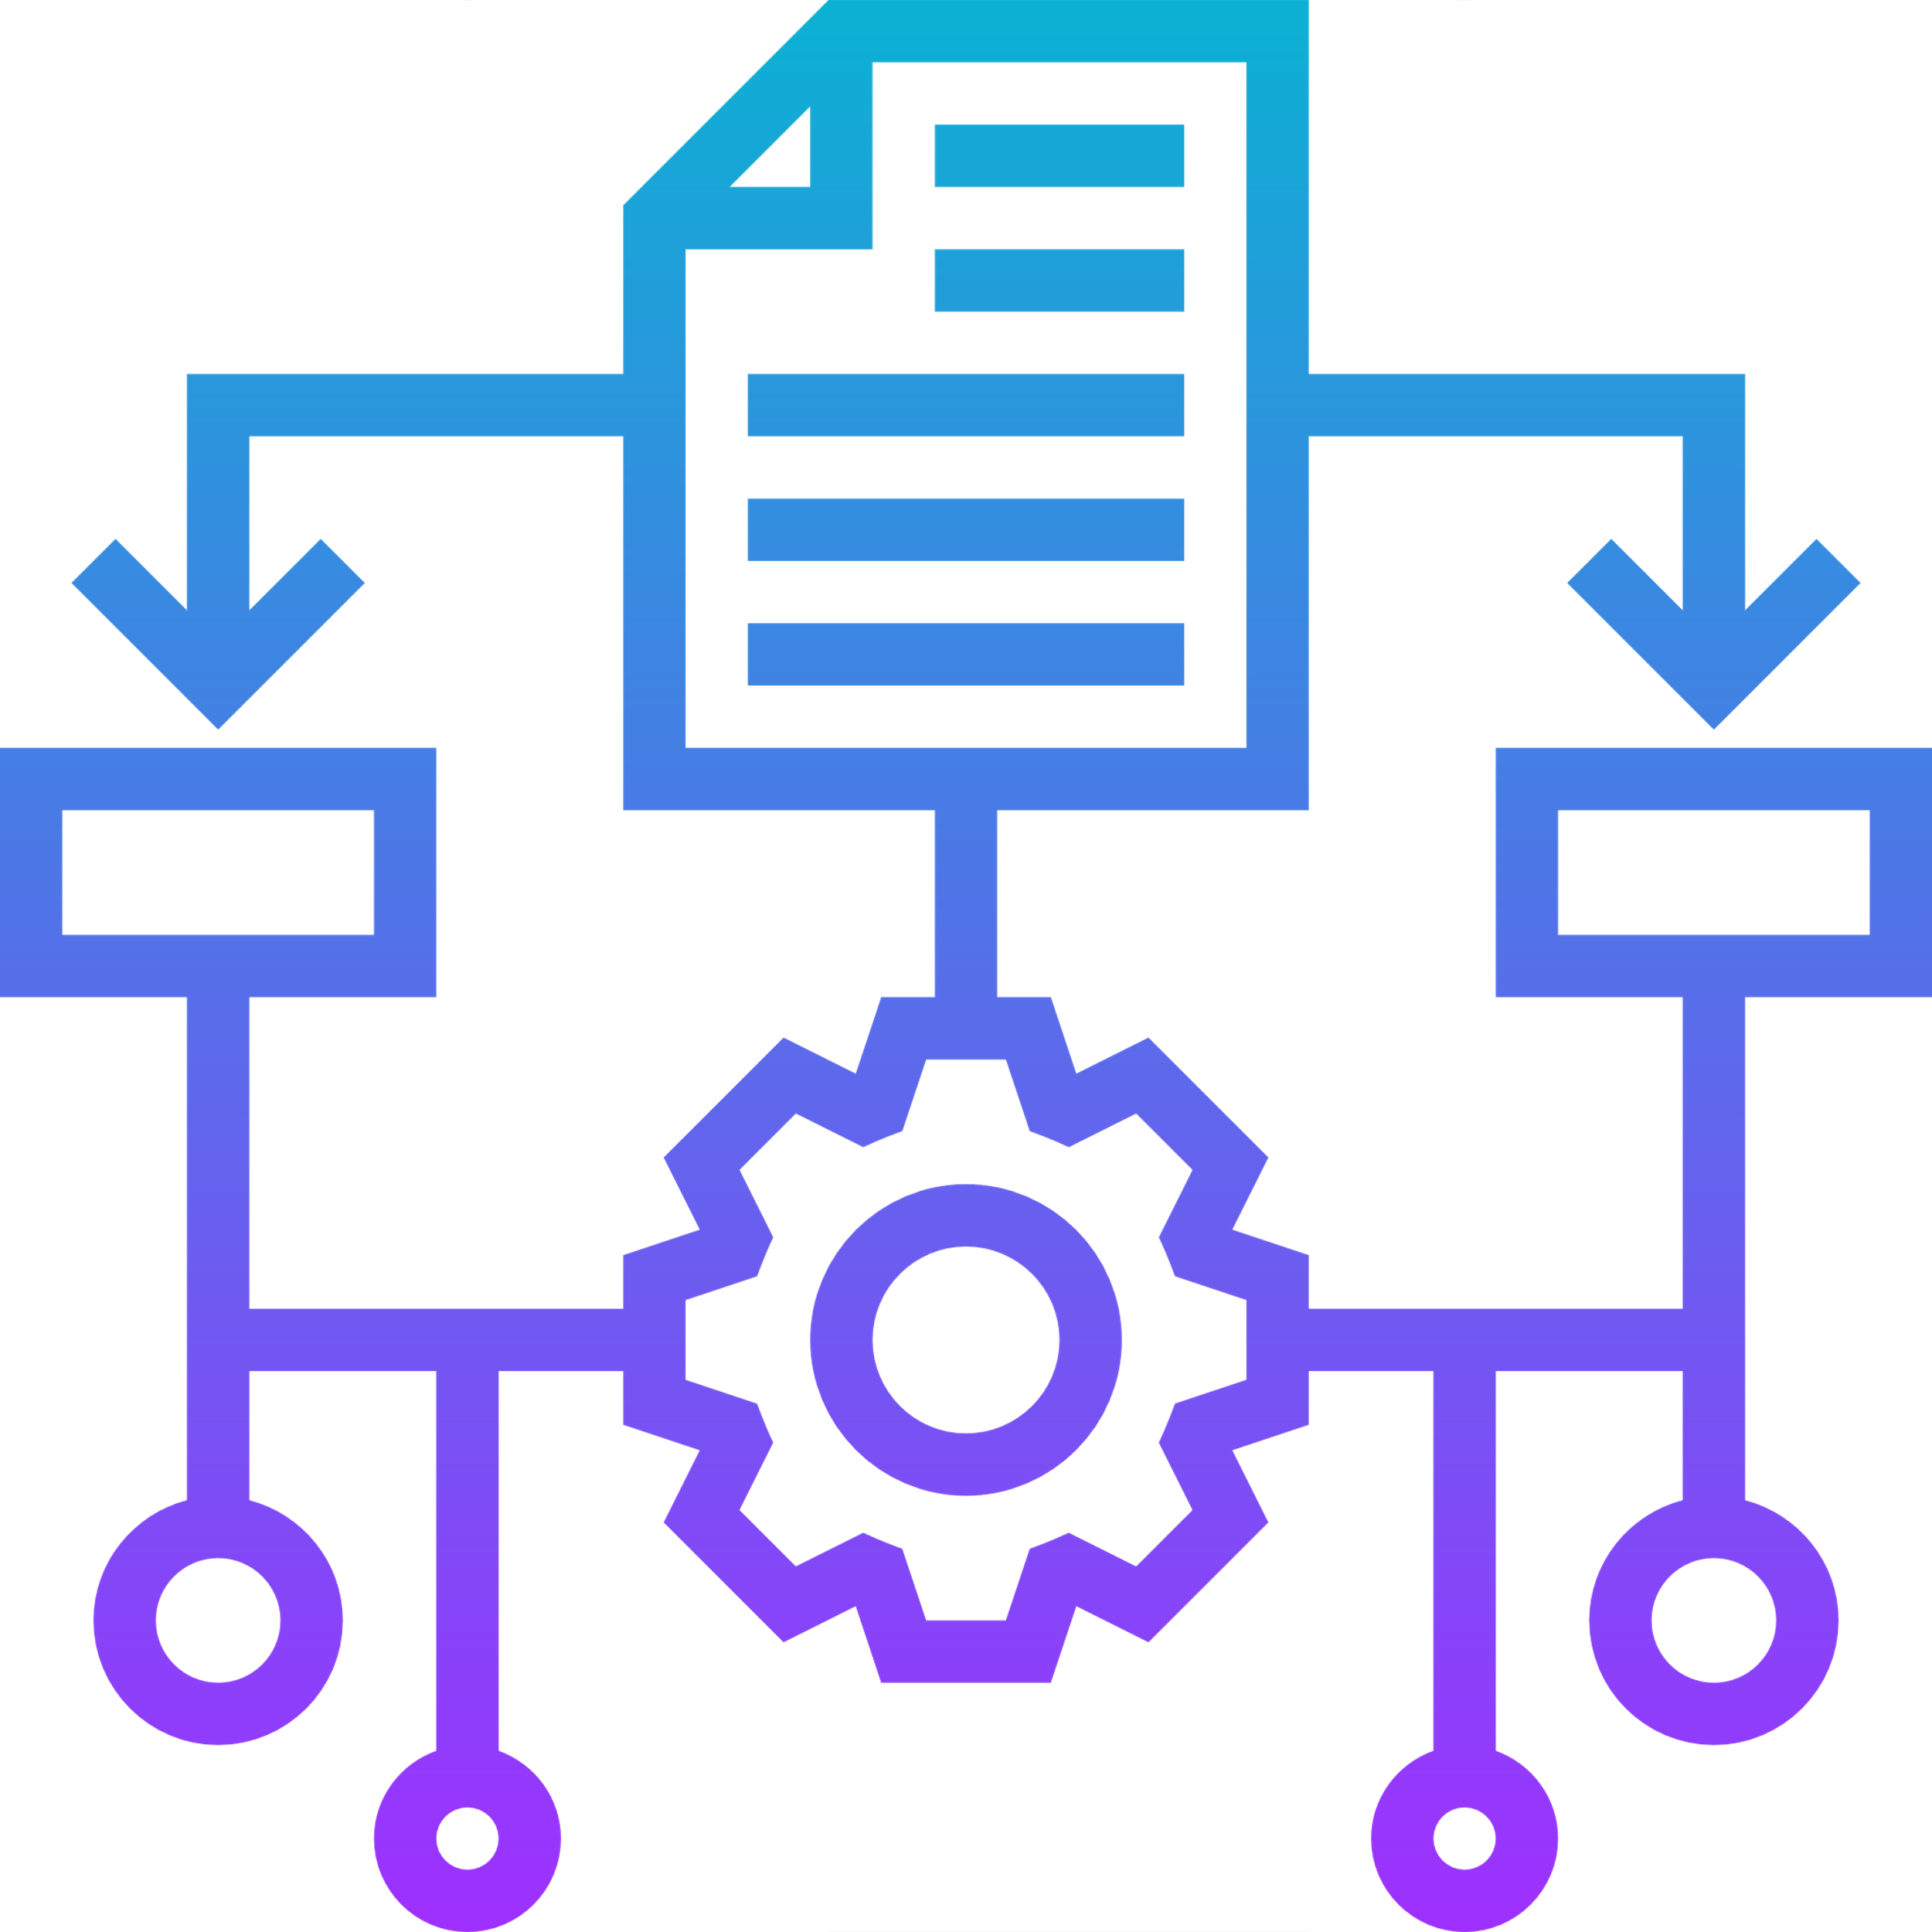






WHY PYTHON FOR AI?
Less code
Platform Independent
Pre-built libraries
Massive Community Support
Ease of learning

Slide 10
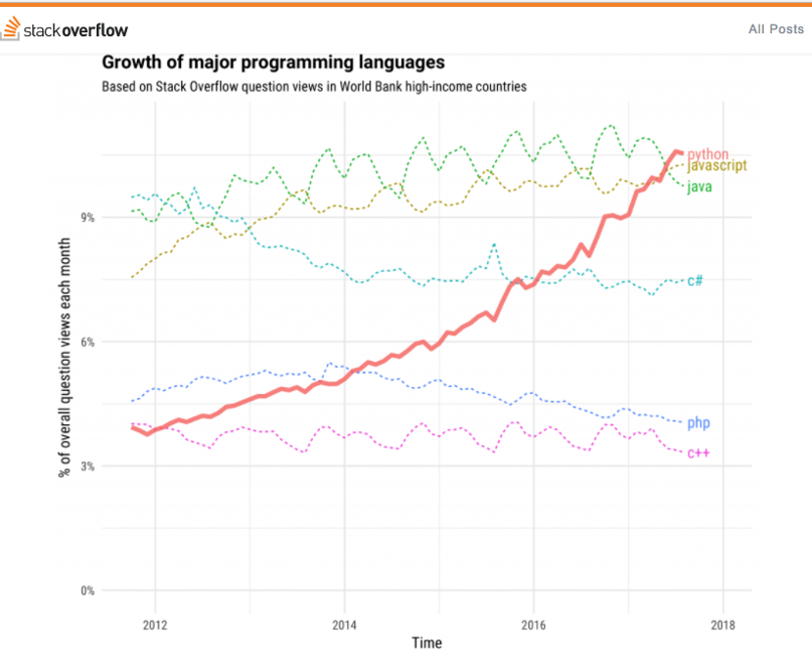
StackOverflow calls it as the fastest growing programming language.
Python is an open-source, object-oriented programming language mainly used for Data Science.

Slide 11
03
PYTHON PACKAGES FOR AI

Slide 12

Features of Tensorflow
Responsive construct
Flexible
Easily trainable
Parallel neural network training
Tensorflow
Tensorflow library was developed by Google in collaboration with Brain Team. It is popularly used in writing Machine Learning algorithms.

Slide 13
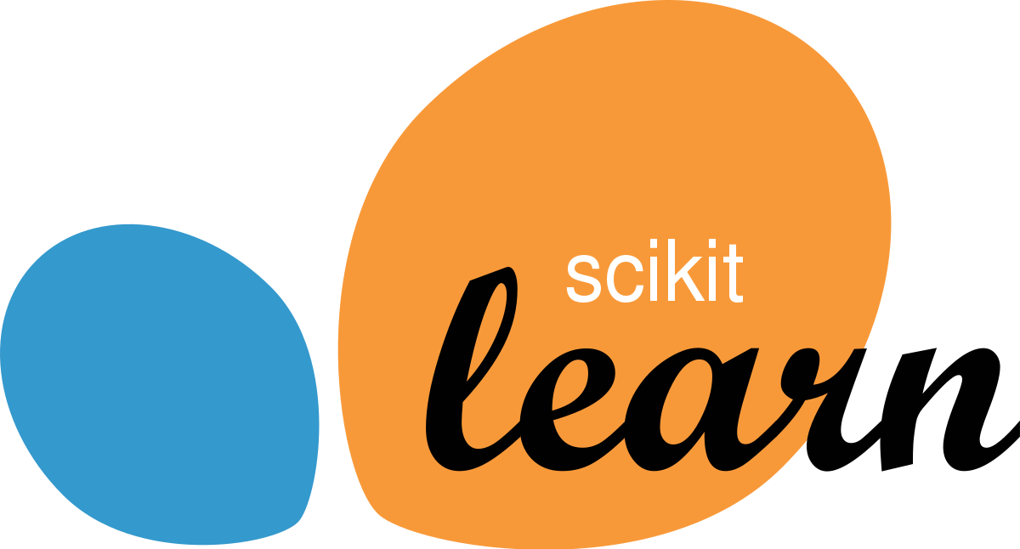
Features of Scikit-learn
Cross validation
Unsupervised learning algorithms
Feature extraction
Scikit-learn
Scikit-learn is a Python library associated with NumPy and SciPy. It is considered as one of the best libraries for working with complex data.

Slide 14

Features of NumPy
Supports multi-dimensional arrays
Numerical analysis
Intuitive
NumPy
Numpy is a python library mainly used for computing scientific/mathematical data.

Slide 15

Features of Theano
Tight integration with NumPy
Transparent use of a GPU
Extensive unit-testing and self-verification
Theano
Theano is a Python library that allows you to define, optimize, and evaluate mathematical expressions involving multi-dimensional arrays efficiently.

Slide 16

Features of Keras
Runs smoothly on both CPU & GPU
Supports all types of Neural Networks
Completely Python based
Keras
Keras simplifies the implementation of neural networks. It also provides some of the best utilities for compiling models, processing data-sets, visualization of graphs, and much more.

Slide 17
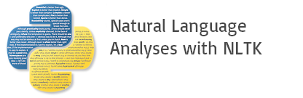
Features of NLTK
Study natural language text
Text analysis
Sentimental analysis
NLTK
The Natural Language Toolkit (NLTK) is an open source Python library for Natural Language Processing, text analysis and text mining.

Slide 18
THANK YOU

